Slide 1
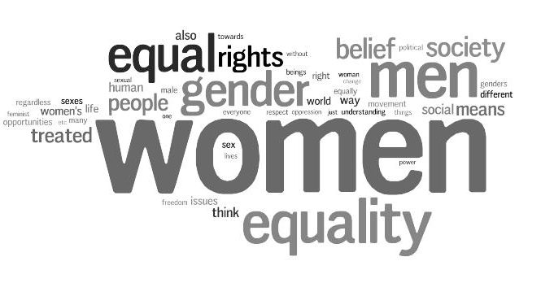
Feminist Theory
Gender in Society

Slide 2
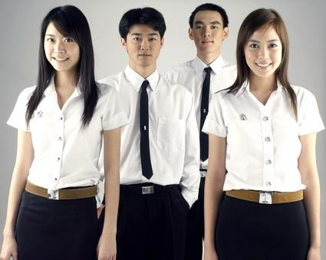
Nature or Nurture
Is the difference between males and females a result of nature or nurture?
1. Males have short hair, females long hair

Slide 3

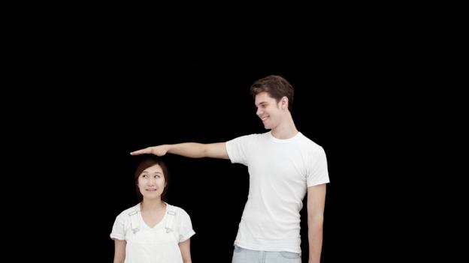
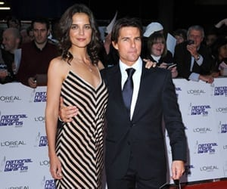
Nature vs Nurture
2. Men are tall, women are short

Slide 4
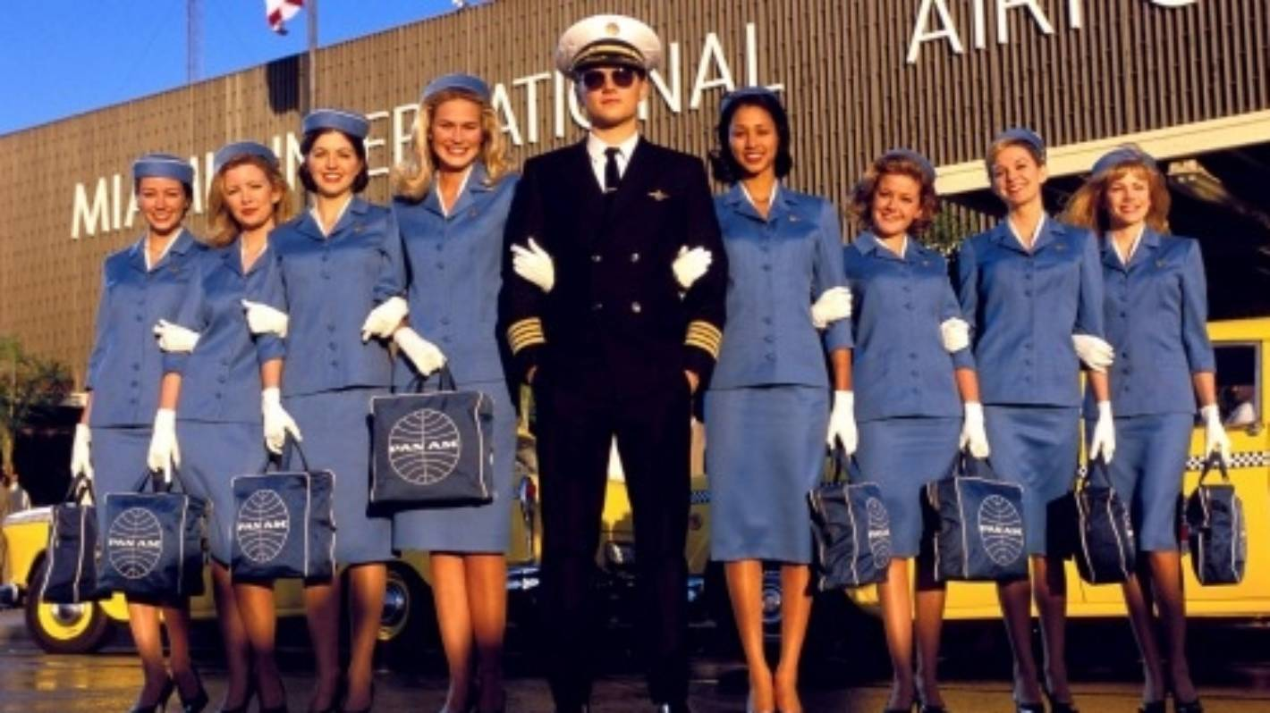
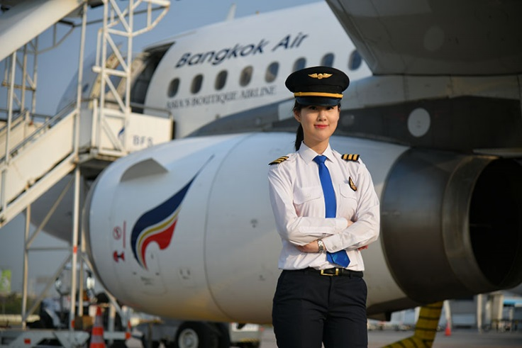
Nature vs Nurture
3. Males are pilots, females are air hostesses

Slide 5
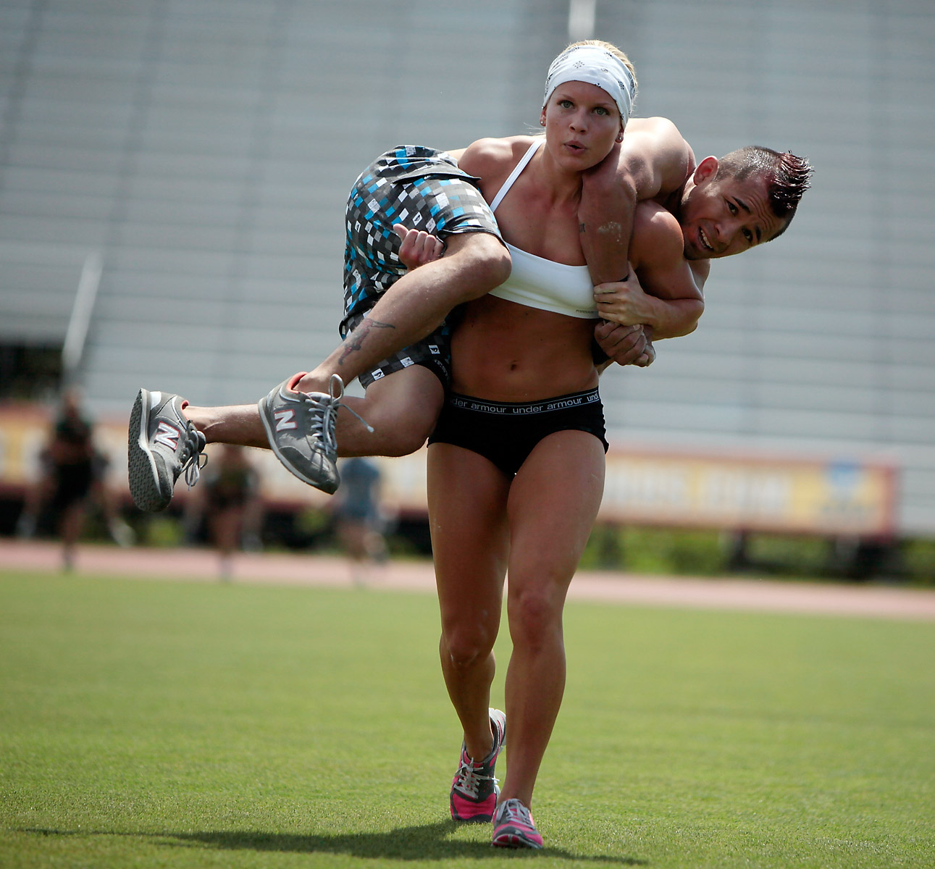
Nature vs Nurture
4. Males have more muscle mass than Females

Slide 6
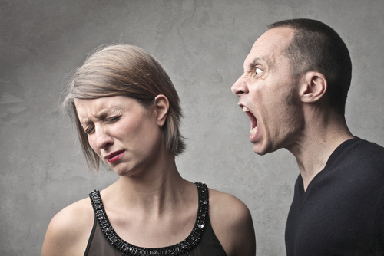
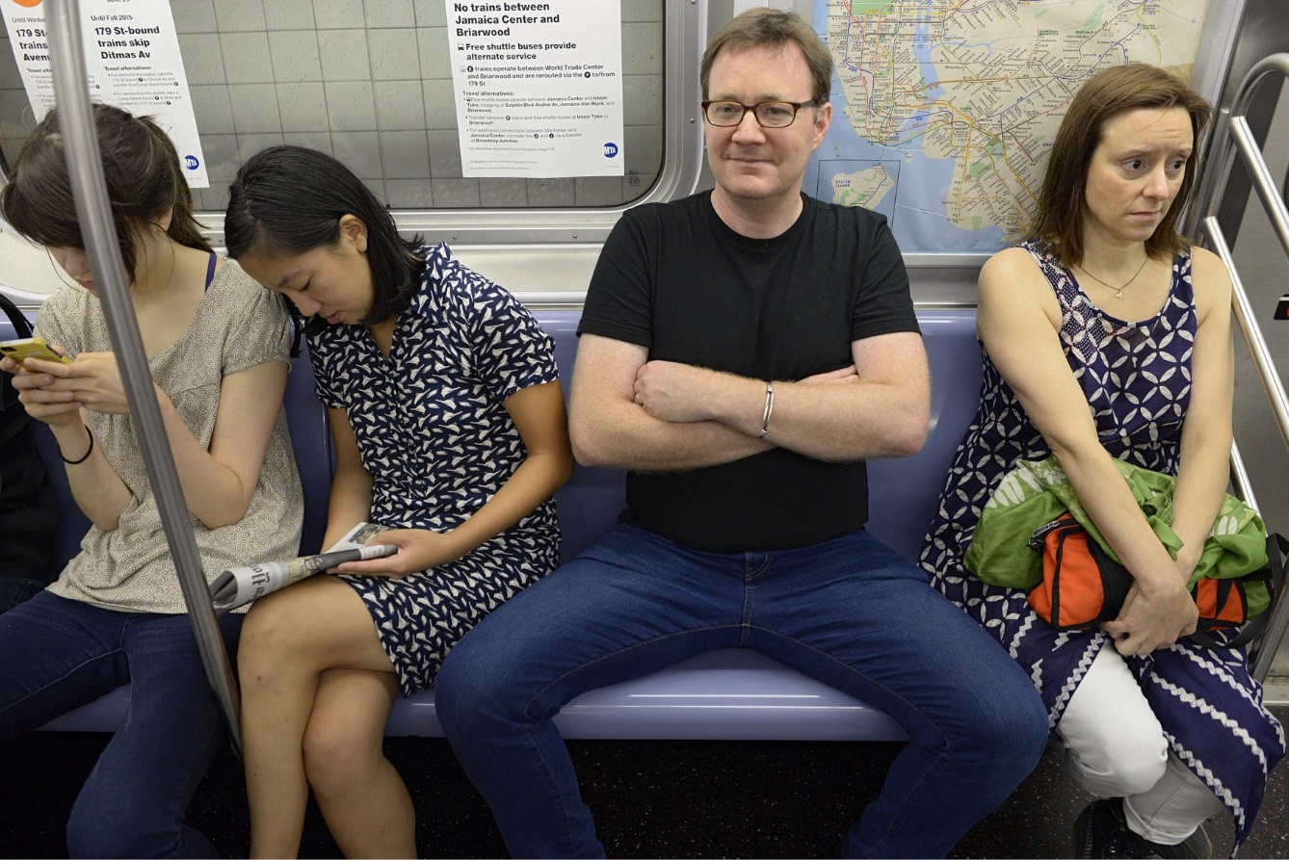
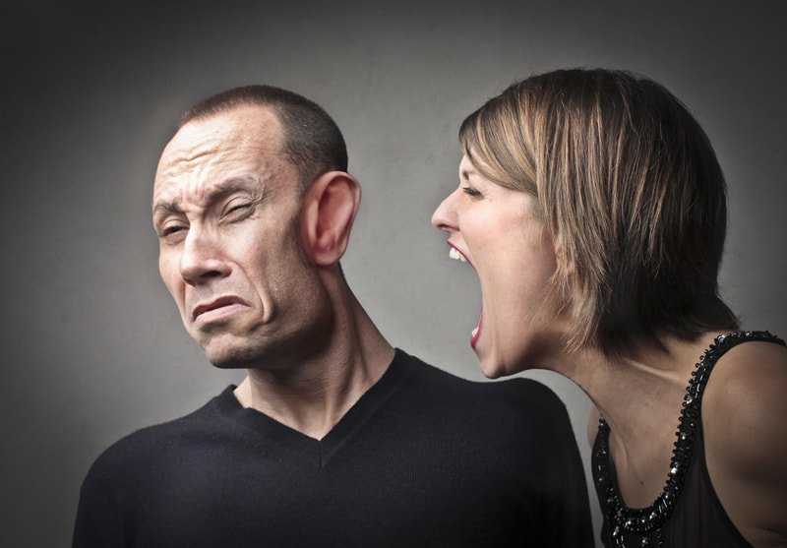
Nature vs Nurture
5. Males are rude, women are polite

Slide 7
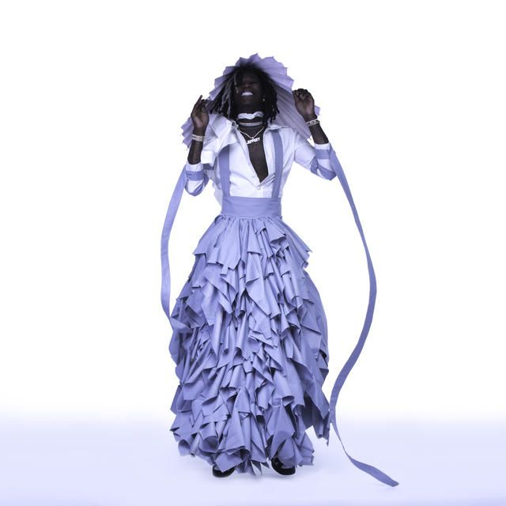

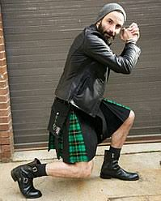
Nature vs Nurture
6. Males wear pants, Females wear skirts and dresses
Brainstorm: Why do women wear skirts? What effect do they have on women?

Slide 8
Feminist Theory
An analysis of women’s subordination for the purpose of figuring out how to change it
The origin and nature of inequality
The social construction of sex and gender
Gender Inequality
Males and females are not equal in society
Patriarchy
Males hold most positions of power in society
Results in discrimination, exploitation, oppression, and violence

Slide 9
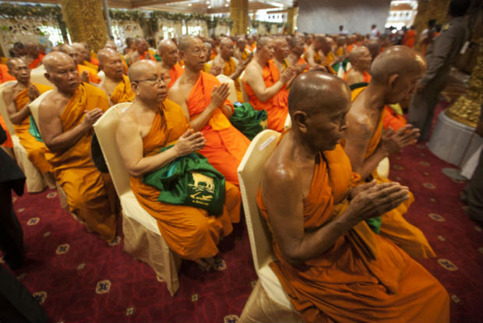
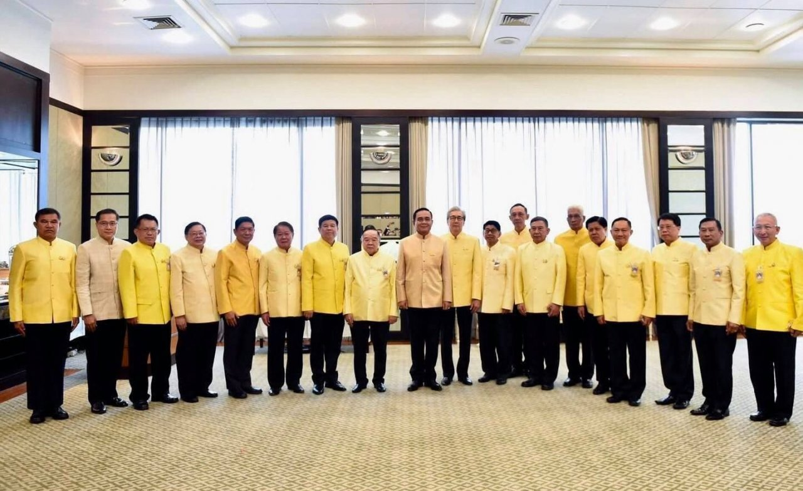
Patriarchy
Is the social system in which men hold power
Political, Moral, Social, Economic, Property
Political
Prime Minister: 1/29 a Woman
Parliament: Pre-Coup 15.8%, Post-Coup >5%
Moral
Sangha Supreme Council all male
Economic & Property
Patrilineal
Gender Wage Gap
Glass Ceiling

Slide 10
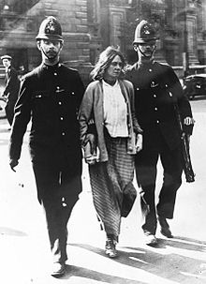
Patriarchal Ideology
Idea that inequality results from biology
Biological difference justifies inequality
Feminists disagree
Gender roles mostly not the result of biology
Women equally capable of performing most roles
Ideology contributes to exploitation and oppression
Women deserve equality
Sexism – discrimination or stereotyping of someone because of their sex (usually women)
Misogyny – dislike or hatred of women

Slide 11
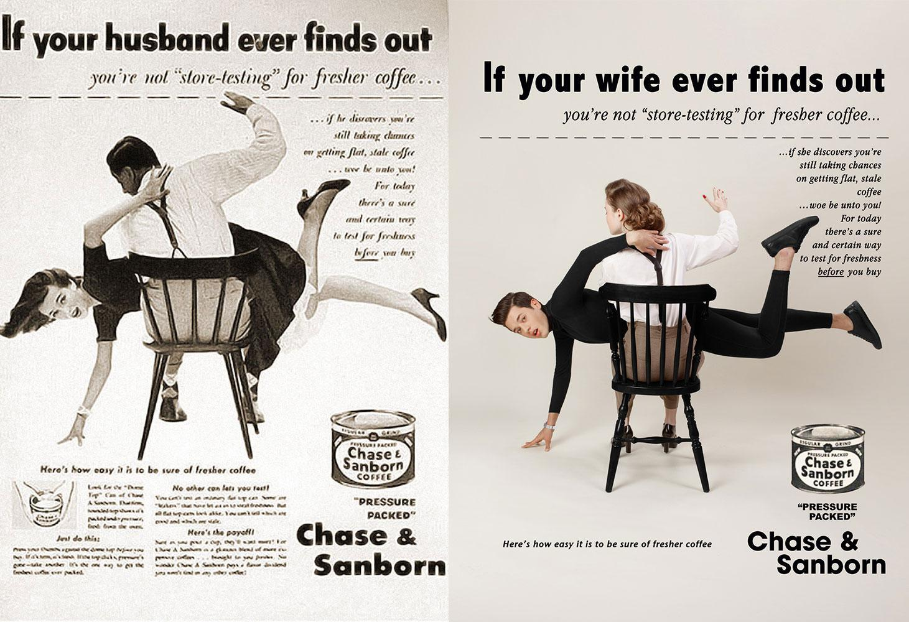

Slide 12
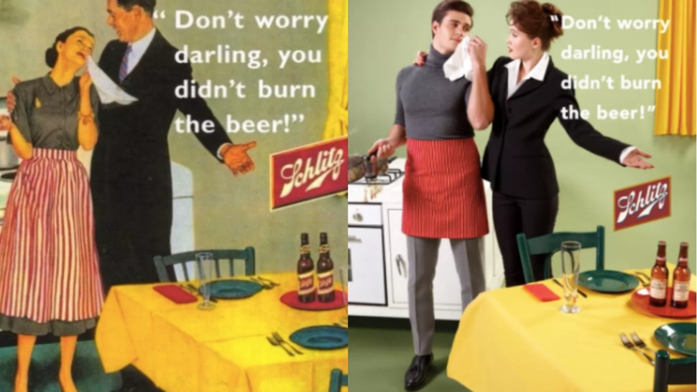
Gender Roles
A set of social norms that say what is acceptable behavior for each gender (roles, behaviors, activities, attributes)
Biological determination
Social construct
Traditional male role
Ex: Work outside, make $
List 5 more
Traditional female role
Ex: Housework, childcare
List 5 more

Slide 13
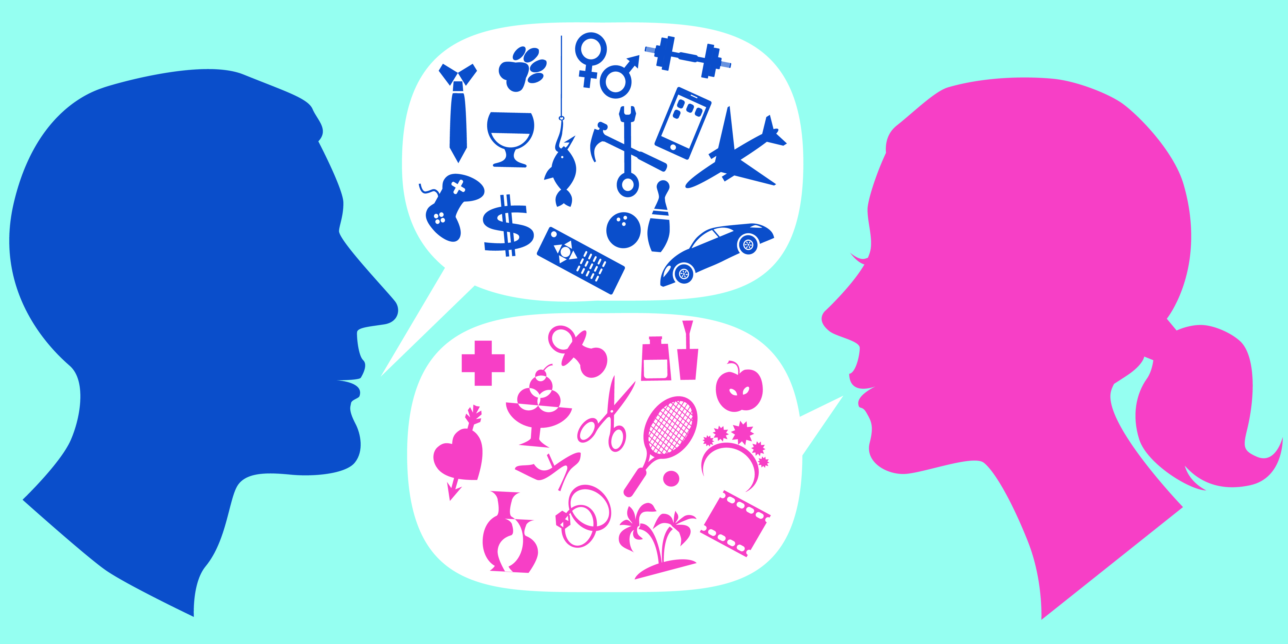
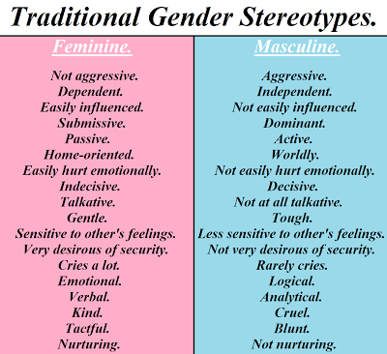
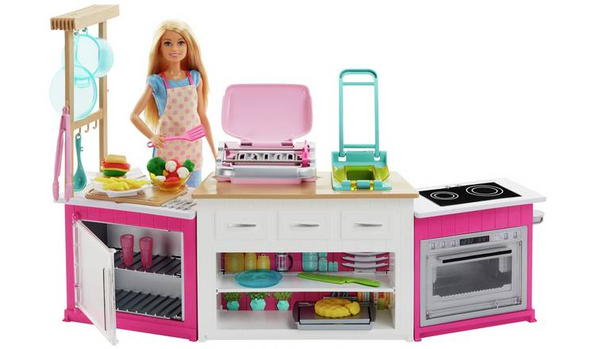
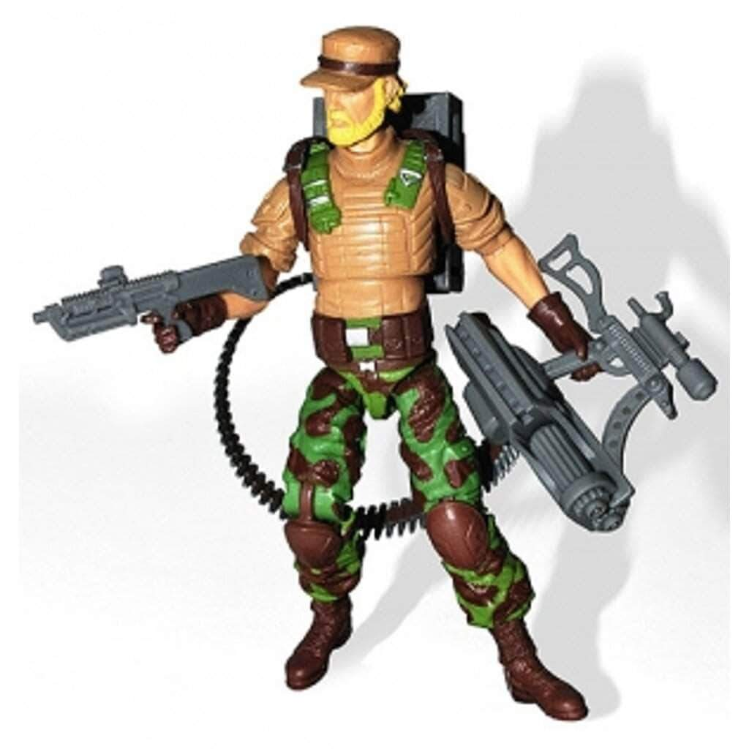
Gender Socialization
The process of learning of learning the expectations and attitudes associated with one’s sex
Boys and girls are socialized differently based on their sex
Children learn their gender by age of 3

Slide 14
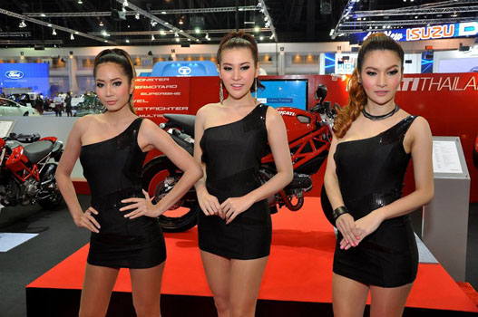
Gender Roles in Media
Dominant culture reinforces gender roles
Gender socialization
Gender in Music Videos
Males: $$$, boss
Females: sexual objects, subordinate
Objectification
To treat someone as if they were an object
Not human, not capable of thought, action

Slide 15
Effects of Gender Roles
Conformity
Pressure to conform
Deviance can be punished
3rd or transgender excluded and punished
Females
Potential limited
Education and Career choices
Discrimination
Hyper-Femininity
Males
Toxic Masculinity

Slide 16
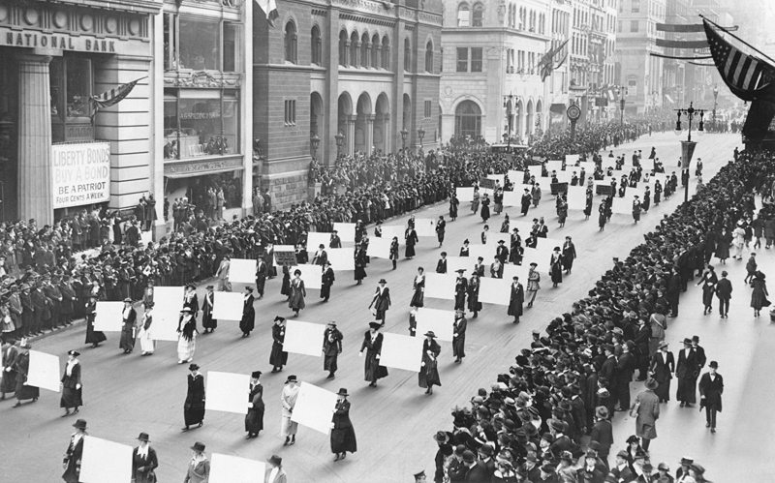
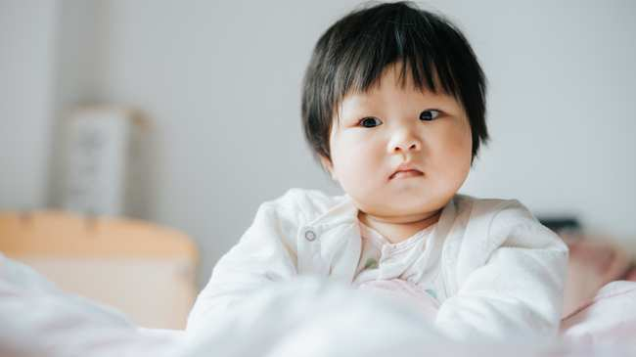
Discrimination
“The husband is the fore leg of the elephant. The wife is the hind leg”
Gender Roles
Men favored
Women secondary
Inheritance
Patrilineal (boys inherit property)
Education
Boys educated
Political Rights
Denied right to vote
Misogyny
In Real Life & online
China’s “Missing Girls”
-Son Preference
Girls aborted

Slide 17
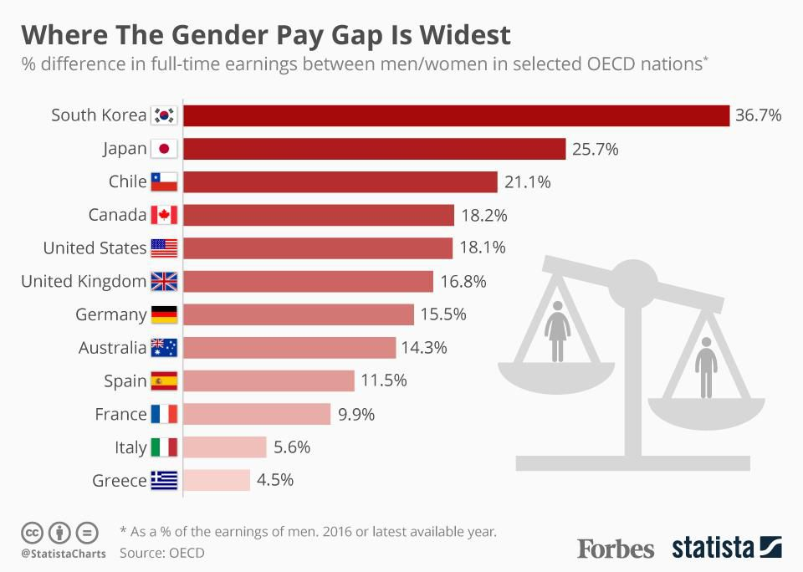
Exploitation
Traditional Female Gender Role:
Housework, Childcare
Unpaid labor
Dependent on husband
Gender Wage Gap
Men paid more than women
Division of Labor: higher paid positions
Unequal pay for equal work
Women paid 92% of men’s salary in Thailand
Glass Ceiling
Discrimination
Stereotypes

Slide 18
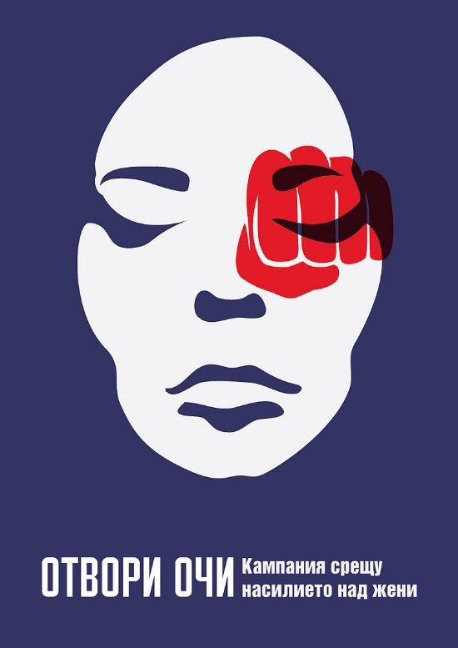
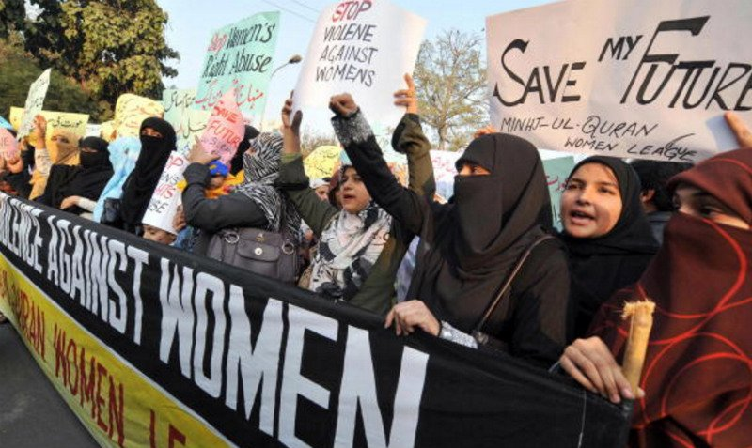
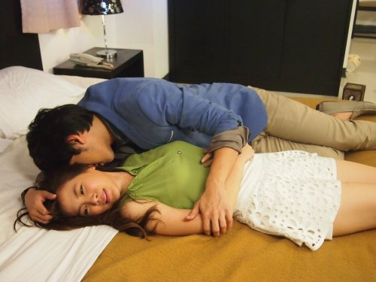

Violence
Violence against women
Physical and sexual
Rape and Marital Rape
Domestic abuse
“Honor Killings”
Forced Marriage
Human trafficking
Violence against LGBT
People who don’t conform
To sex at birth
Traditional gender roles
Rape Culture: Rape in the media
No Means NO

Slide 19
Vocab 1
Patriarchy – social system in which males hold power
Gender Roles – a set of social norms that say what is acceptable behavior for each gender
Stereotype – a widely held but fixed and oversimplified idea about a type of person
Social Construct – an idea that seems natural but is actually invented by society

Slide 20
Vocab 2
Discrimination – different treatment of someone because of their group
Double Standard – rule that is unfairly applied to different people or groups
Objectification – treating someone as if they were an object
Glass Ceiling – an invisible barrier to advancement for women and minorities

